Slide 1
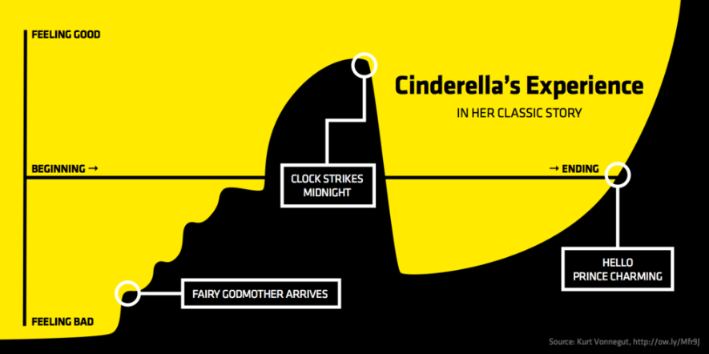
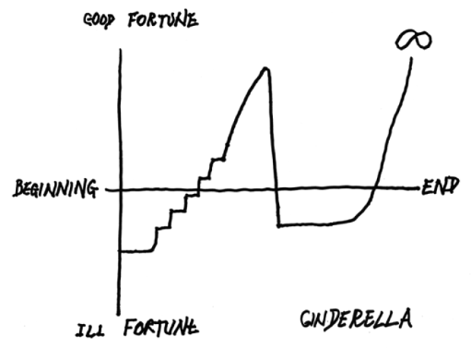
Preface
This was further defined in a literary study at The University of Vermont which proposed the shapes below.
Vonnegut’s had additionally proposed an ‘ambiguous’ shape, which I have added.
In 1945, for his Master’s thesis, author Kurt Vonnegut, proposed that all stories have a literal shape based on the protagonists’ fortune.
Rags to riches (rise)
Riches to rags (fall)
Man in a hole (fall-rise)
Icarus (rise-fall)
Cinderella (rise-fall-rise)
Oedipus (fall-rise-fall)
Lifelike Ambiguity (Is it good, is it bad?)
Using Cinderella as a model, he originally compared the shape to the New Testament. Cinderella rises, Cinderella falls, Cinderella rises to infinite bliss. (rise-fall-rise)

Slide 2
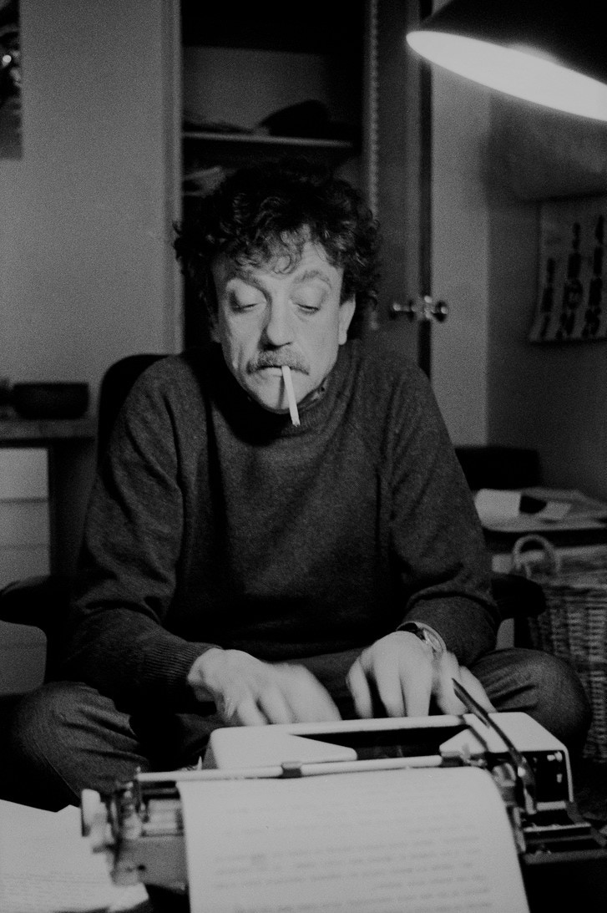
“The fundamental idea is that stories have shapes which can be drawn on graph paper, and that the shape of a given society’s stories is at least as interesting as the shape of its pots or spearheads.” -Vonnegut
His thesis was rejected.
I am now applying his rejected thesis to 600 of the most important films ever made.

Slide 3
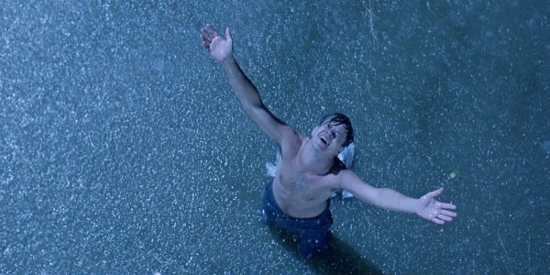
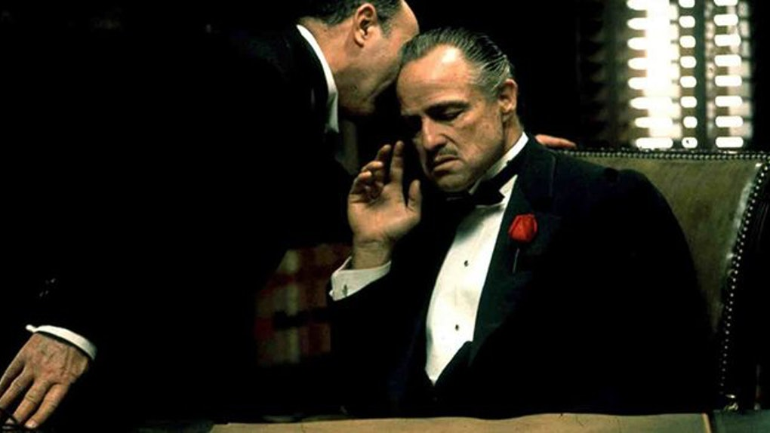

The Shape of Film
A Jason McDonald Production

Slide 4
Starring

Slide 5
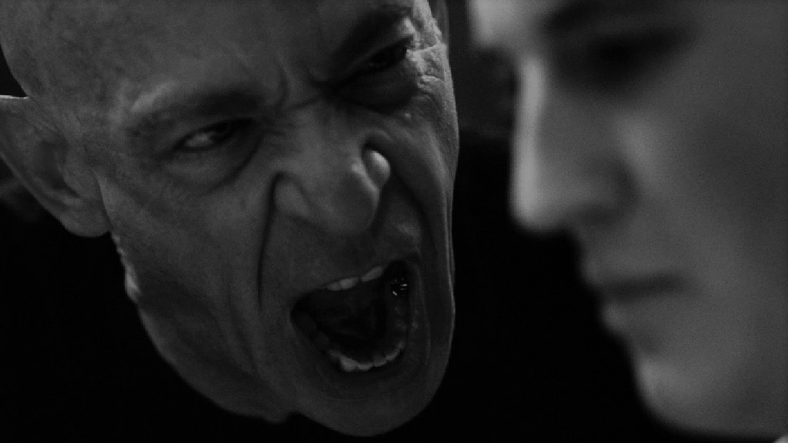
Man in Hole as ‘Fall then Rise’

Slide 6
Cinderella as ‘Rise-Fall-Rise’

Slide 7
Icarus as ‘Rise then Fall’

Slide 8
Riches to Rags as ‘Fall’

Slide 9
Rags to Riches as ‘Rise’

Slide 10
Oedipus as ‘Fall – Rise – Fall’

Slide 11
Lifelike Ambiguity
Is it good? Is it bad?
?
And featuring ‘Misc’

Slide 12
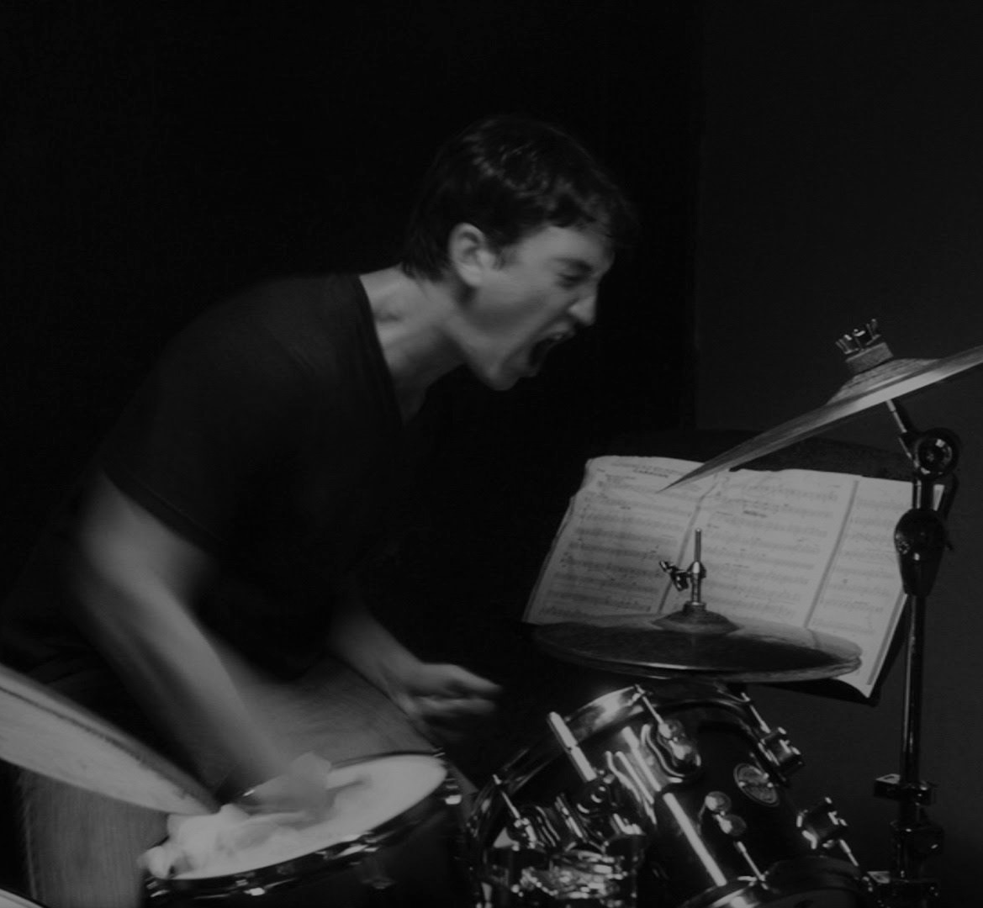
The Movies

Slide 13
Sight & Sound Top 250 Films (The Critics)
“I Know Where I’m Going!”
2001: A Space Odyssey
A Brighter Summer Day
A Canterbury Tale
A City of Sadness
A Clockwork Orange
A Man Escaped
A Matter of Life and Death
A Tale of Tales
A Touch of Zen
A Trip to the Moon
A Woman Under the Influence
Aguirre, Wrath of God
Amarcord
An Autumn Afternoon
Andrei Rublev
Annie Hall
Apocalypse Now
Army of Shadows
Au Hasard Balthazar
Badlands
Barry Lyndon
Battleship Potemkin
Beau Travail
Berlin Alexanderplatz
Bicycle Thieves
Black Narcissus
Blade Runner
Blow Up
Blue Velvet
Breaking the Waves
Breathless
Brief Encounter
Bringing Up Baby
Casablanca
Celine and Julie Go Boating
Chelsea Girls
Children of Paradise
Citizen Kane
City Lights
Cleo From 5 to 7
Close-Up
Come and See
Cries and Whispers
Daisies
Day of Wrath
Days of Heaven
Diary of a Country Priest
Distant Voices, Still Lives
Do the Right Thing
Don’t Look Now
Dr. Strangelove or How I Stopped Worrying and Learned to Love the Bomb
Duck Soup
E.T.
Earth
Eraserhead
Faces
Fanny and Alexander
Fear Eats the Soul

Slide 14
IMDB Top 250 User Rated Films (The People)
The Shawshank Redemption
The Godfather
The Godfather: Part II
The Dark Knight
12 Angry Men
Schindler's List
The Lord of the Rings: The Return of the King
Pulp Fiction
The Lord of the Rings: The Fellowship of the Ring
Fight Club
Forrest Gump
Inception
Star Wars: Episode V - The Empire Strikes Back
The Lord of the Rings: The Two Towers
The Matrix
Goodfellas
One Flew Over the Cuckoo's Nest
Joker
Se7en
It's a Wonderful Life
The Silence of the Lambs
Alien
Avengers: Endgame
Raiders of the Lost Ark
Apocalypse Now
Memento
Avengers: Infinity War
Django Unchained
Paths of Glory
Spider-Man: Into the Spider-Verse
Witness for the Prosecution
Sunset Blvd
The Shining
WALL-E
Dr. Strangelove or How I Stopped Worrying and Learned to Love the Bomb
The Dark Knight Rises
Once Upon a Time in America
Coco
Aliens
American Beauty
Braveheart
Star Wars: Episode VI - Return of the Jedi
Amadeus
Star Wars: Episode IV - A New Hope
Saving Private Ryan
The Green Mile
Interstellar
Léon: The Professional
The Usual Suspects
Modern Times
The Lion King
City Lights
American History X
The Pianist
Back to the Future
Terminator 2: Judgment Day
Gladiator
Psycho
The Departed
Whiplash
The Prestige
Casablanca
Rear Window
The Great Dictator

Slide 15
200 Highest Grossing Movies (The Money)
Avengers: Endgame
Avatar
Titanic
Star Wars: Episode VII - The Force Awakens
Avengers: Infinity War
Jurassic World
The Lion King
The Avengers
Furious Seven
Avengers: Age of Ultron
Black Panther
Harry Potter and the Deathly Hallows: Part 2
Star Wars: Episode VIII - The Last Jedi
Jurassic World: Fallen Kingdom
Frozen
Beauty and the Beast
Incredibles 2
The Fate of the Furious
Iron Man Three
Minions
Captain America: Civil War
Aquaman
Spider-Man: Far from Home
Captain Marvel
Transformers: Dark of the Moon
The Lord of the Rings: The Return of the King
Skyfall
Transformers: Age of Extinction
The Dark Knight Rises
Toy Story 4
Toy Story 3
Pirates of the Caribbean: Dead Man's Chest
Joker
Rogue One
Aladdin
Pirates of the Caribbean: On Stranger Tides
Frozen II
Despicable Me 3
Alice in Wonderland
Zootopia
The Hobbit: An Unexpected Journey
The Dark Knight
Harry Potter and the Sorcerer's Stone
Despicable Me 2
The Lion King
The Jungle Book
Jumanji: Welcome to the Jungle
Pirates of the Caribbean: At World's End
Harry Potter and the Deathly Hallows: Part 1
The Hobbit: The Desolation of Smaug
The Hobbit: The Battle of the Five Armies
Finding Nemo
Harry Potter and the Order of the Phoenix
Harry Potter and the Half-Blood Prince
The Lord of the Rings: The Two Towers
Shrek 2

Slide 16
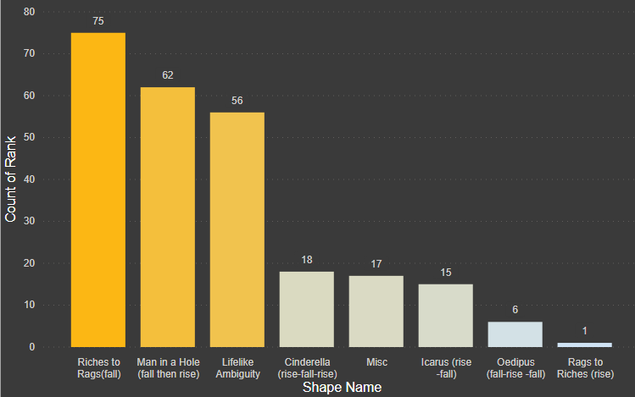
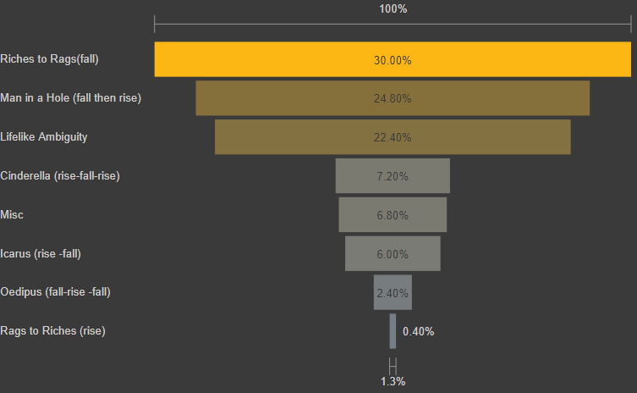
Sight & Sound
Critics Breakdown
Riches to Rags, Lifelike Ambiguity, Icarus, and Oedipus make up 60.8% of movies on the Sight & Sound Critics list.
Rags to Riches (rise) makes up a mere .40%.
Translation:
Death and failure in film is highly respected.

Slide 17
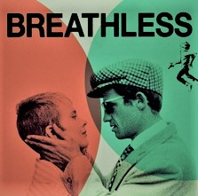
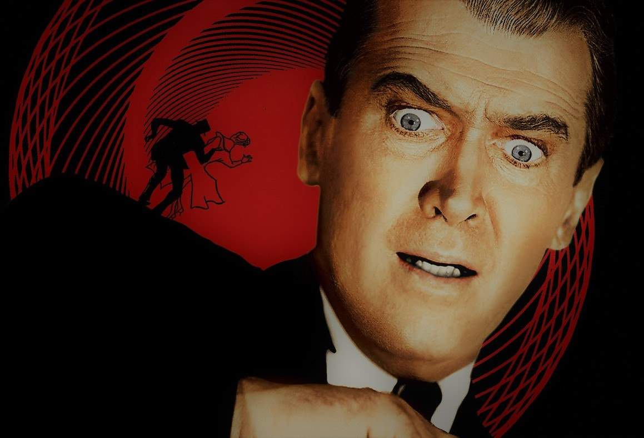



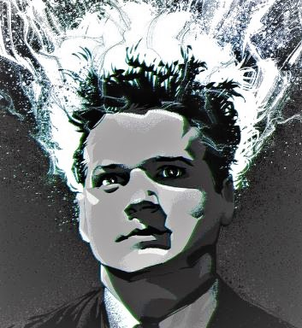
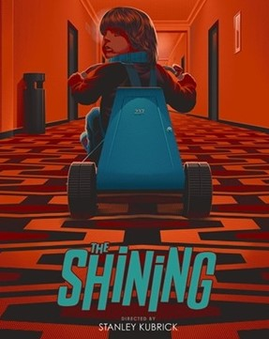
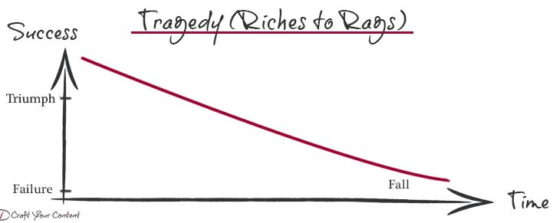
13. Breathless
1. Vertigo
113. Dr. Strangelove
Sight & Sound
Riches to Rags (fall)
78. Chinatown
195. Eraserhead
156. The Shining

Slide 18
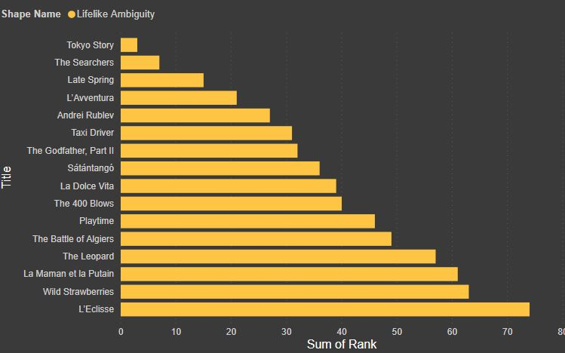
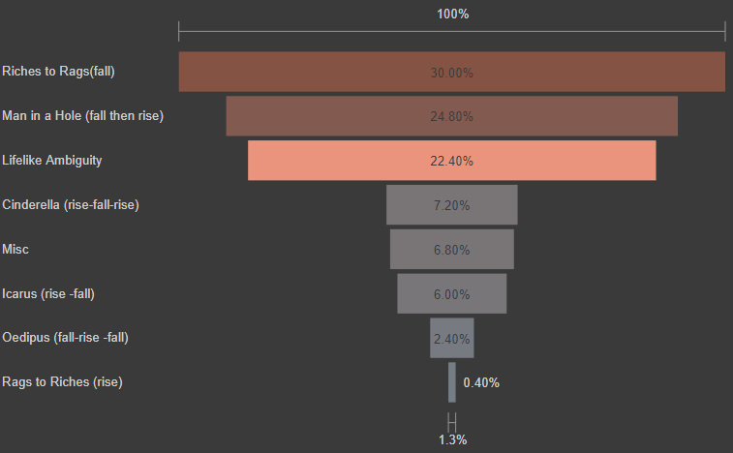
Sight & Sound
Lifelike Ambiguity(Is it good? Is it bad?)
56 total ambiguous endings
Makes up 22.4% of critics list.
Highest Rank: 3 (Tokyo Story)

Slide 19

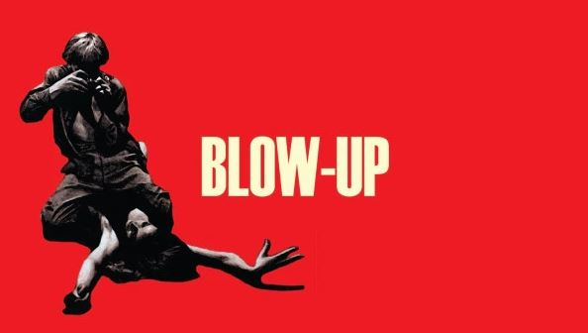
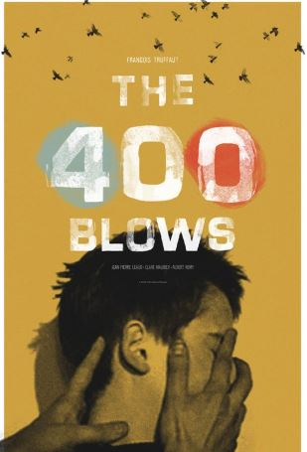
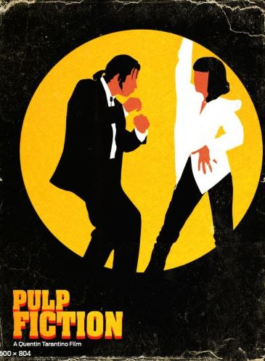
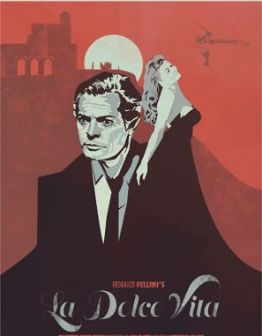
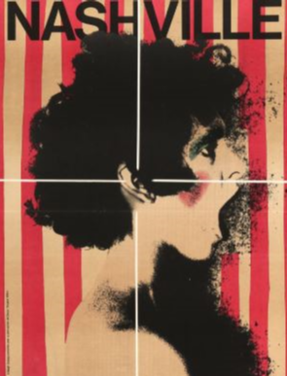
31. Taxi Driver
144. Blow-Up
40. 400 Blows
Sight & Sound
?
Lifelike Ambiguity
133. Pulp Fiction
39. La Dolce Vita
77. Nashville
Is it good? Is it bad?

Slide 20
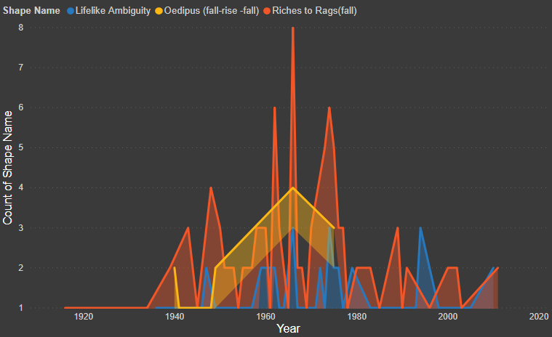
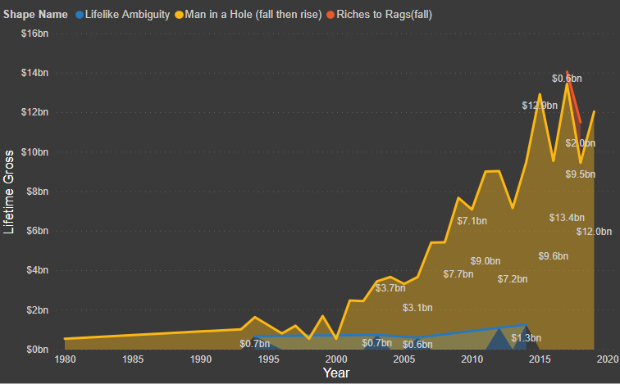
Sight & Sound By Year
The critic’s list peaks in 1966 with a total of 10 movies released. Eight of the 10 stories send the protagonist into downward spiral or an uncertain outcome.
Much of the influence was spawned from post-war French realism (400 Blows, Breathless), which was originally influenced by American Noir of the 1940s, which in-turn influenced 70’s American realism (Chinatown, Godfather).
Then Jaws (1975) and Star Wars (1977) added another element of realism. That men getting out of holes makes more money.

Slide 21
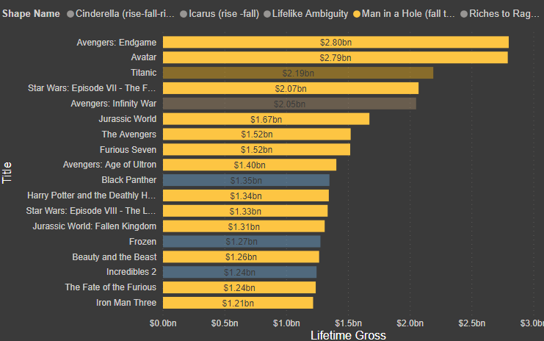
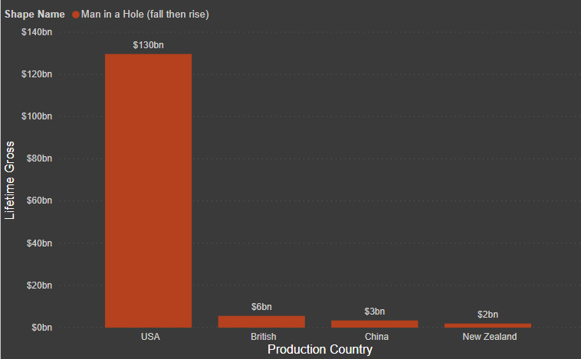
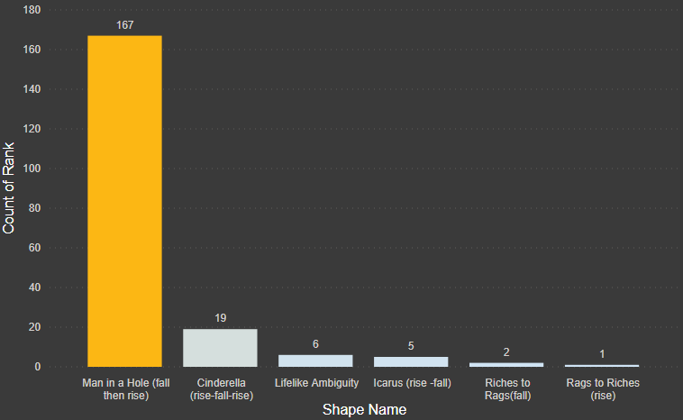
Top Box Office
Man in Hole (fall then rise)
‘Man in Hole’ makes up 85.5% of top box office shapes, totaling $141 billion
The vast majority are produced in the USA
Being in a hole is very profitable, as long as you get out.
Doesn’t have to be a ‘Man’ nor a ‘Hole’.
‘Somebody gets into trouble, then gets out again. People love that story. They never get tired of it.’ - Kurt Vonnegut

Slide 22
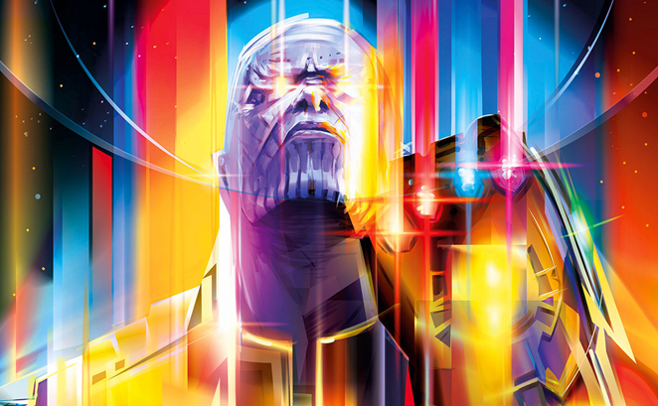
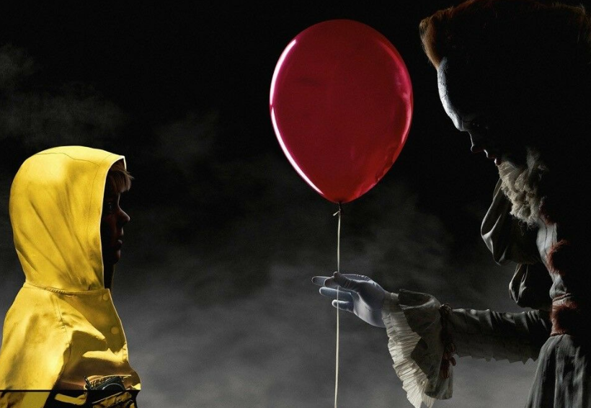

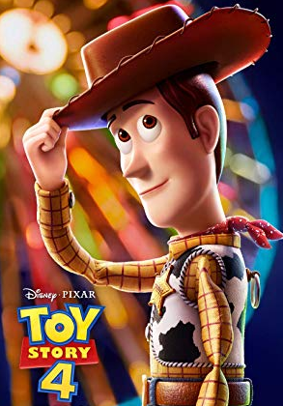
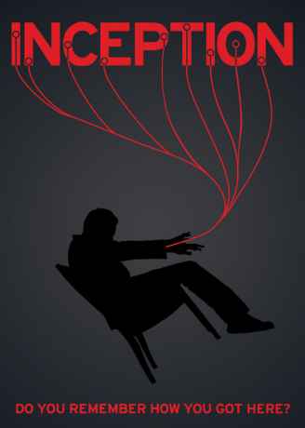
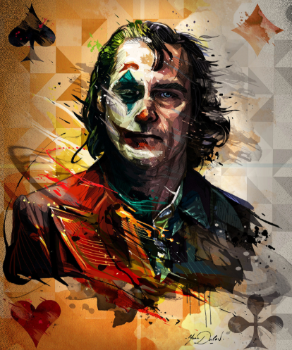
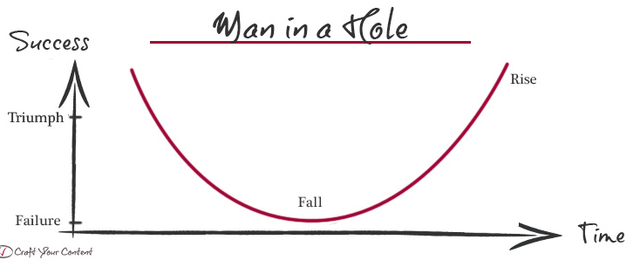
1. Avengers: Endgame
120. It
Top Box Office
Man in Hole (fall then rise)
30. Toy Story 4
79. Inception
33. Joker

Slide 23
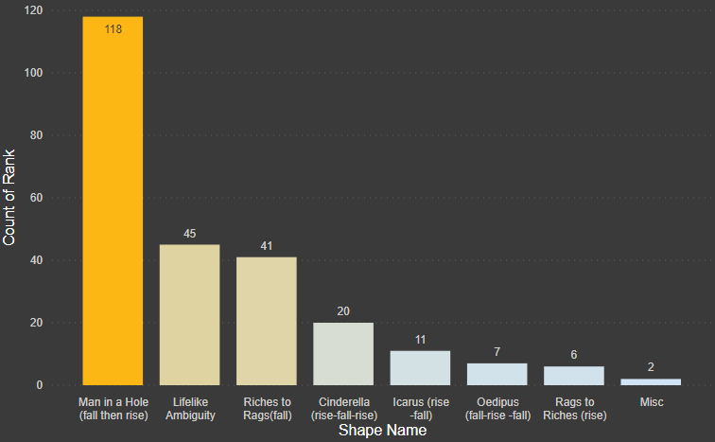
IMDB
(The people)
Much like Top Box office, IMBD users prefer to see a person get out of a hole.
But they also prefer to see our protagonists endure more ups and downs and variation at a slightly higher rate.
Cinderella (rise-fall-rise) 8%
Oedipus (fall-rise-fall) 2.8%
Icarus (rise then fall) 4.4%
Rags to Riches (rise) 2.4%
The Oedipus shape does not appear at all in the Top Box Office data.

Slide 24
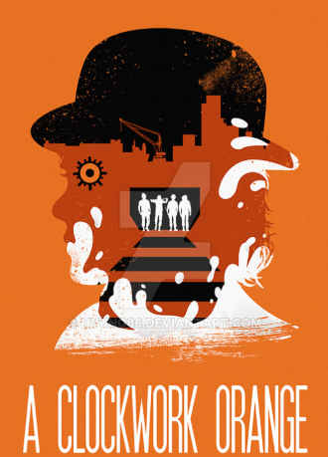
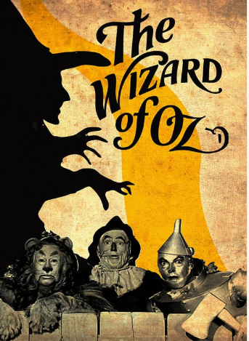
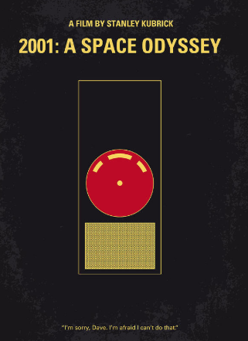

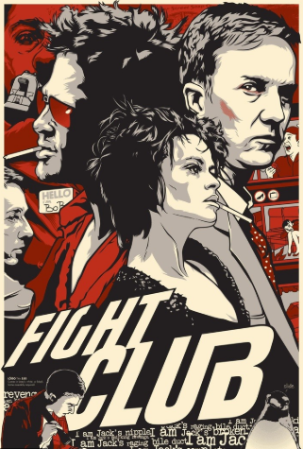

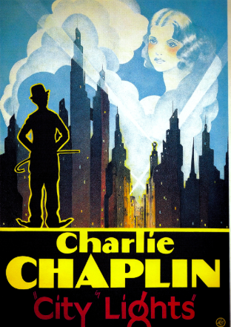
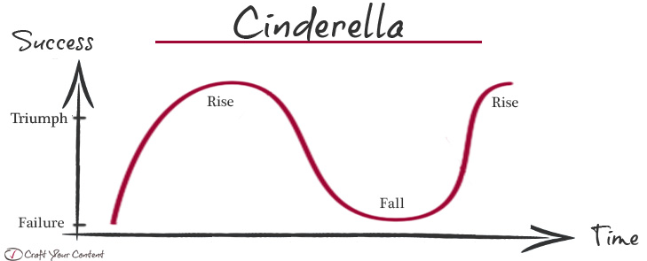
79. A Clockwork Orange
222. The Wizard of Oz
71. 2001: A Space Odyssey
IMDB
Cinderella (rise-fall-rise) 8%
10. Fight Club
77. Singin’ In the Rain
30. City Lights

Slide 25
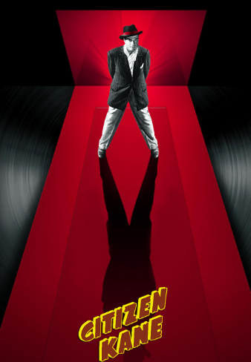
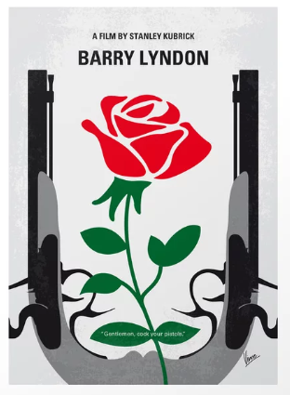



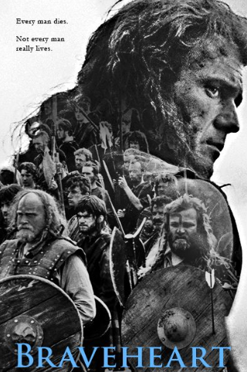
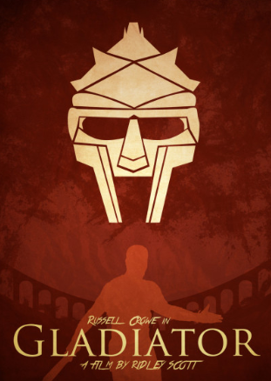
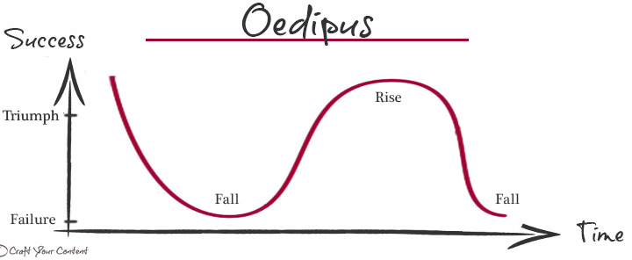
74. Citizen Kane
157. Barry Lyndon
230. Kind Hearts and Coronets
IMDB
Oedipus (fall-rise-fall) 2.8%
121. Elephant Man
62. Braveheart
30. Gladiator

Slide 26
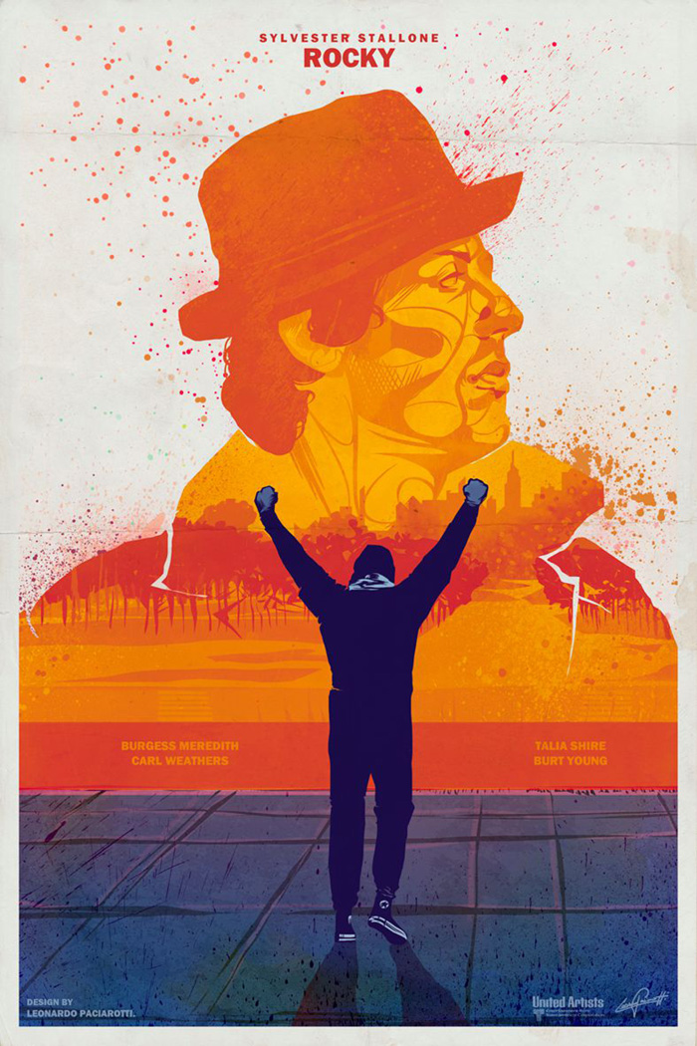
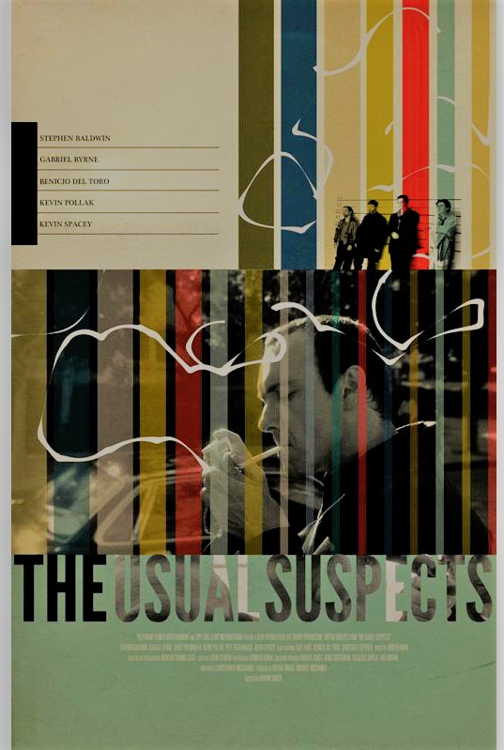


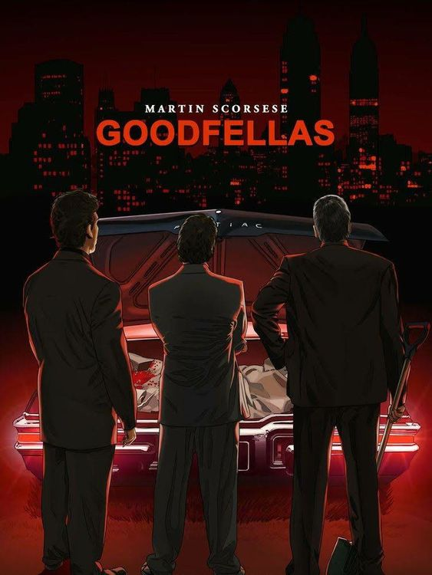
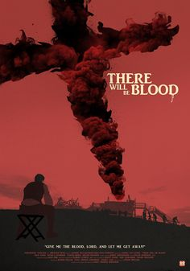
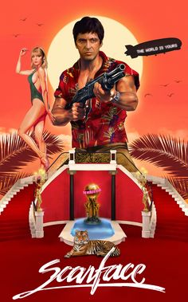
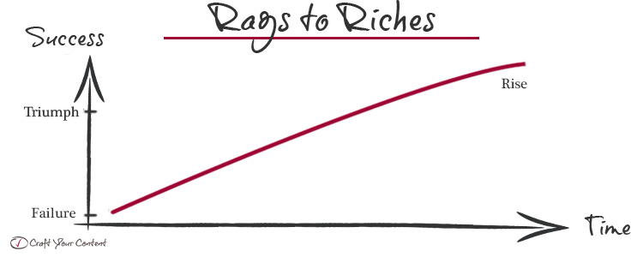

IMDB
Rags to Riches(rise)2.4%
Icarus (rise then fall) 4.4%
183. Rocky
27. The Usual Suspects
16. Goodfellas
119. There Will Be Blood
82. Scarface

Slide 27



Recap
Sight & Sound critics like watching us fall. Or at least not succeed.
Man in hole (fall then rise) rules the box office. Invest in ‘man in hole’.
IMDB users also like watching us fall. But they like watching us get out of hole even more.

Slide 28


Recap
Total

Slide 29

Oh Yeah, 19 movies are listed as ‘Misc’. What is a miscellaneous movie?
Documentaries, montage films, and non-linear art films like Last Year At Marienbad with minimal conflict.
17 of 19 appear in the Sight & Sound dataset.

Slide 30




Producers
Excel
Power BI
And Coffee. Lots of coffee.
Python

Slide 31


